Slide 1
Noticing and Wondering 3
These are a collection of images (all my own) that can be used as discussion starters in your mathematics classroom. When students make statements about what they notice and pose questions about what they wonder it engages them in mathematical thinking and reasoning.
For more information on Noticing and Wondering Max Rey and Annie Fetter from The Math Forum are worth checking out.
Jerry Burkhart has a nice blog about noticing and wondering as does Mark Chubb.
Some of these images would also be good for How Many? lesson starters, Christopher Danielson’s book How many? also has great images.
For further images I recommend Daily Overview or Number Talk Images or your own.
Katherin

Slide 2
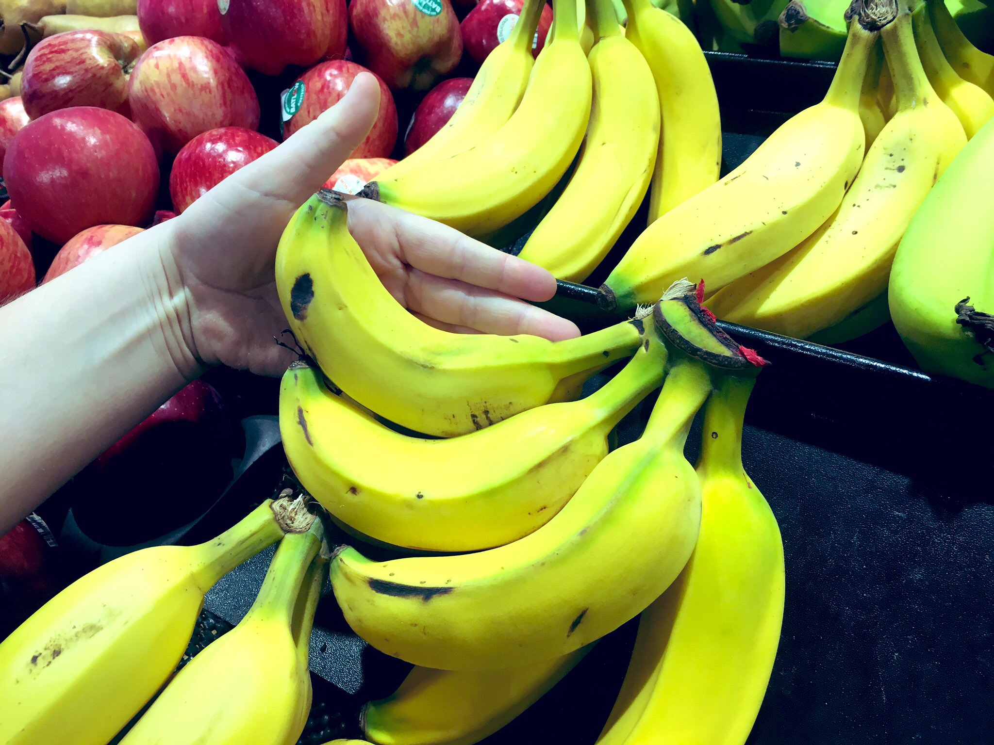

Slide 3
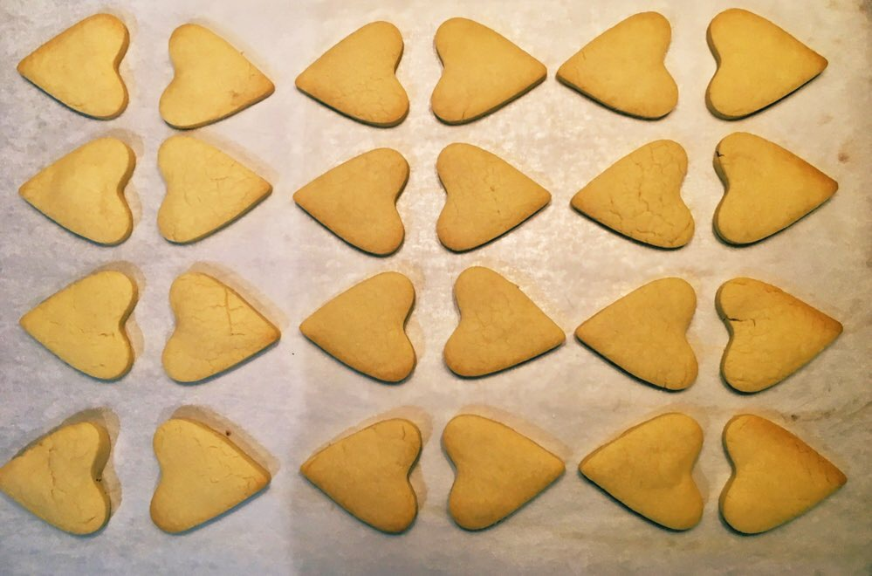

Slide 4
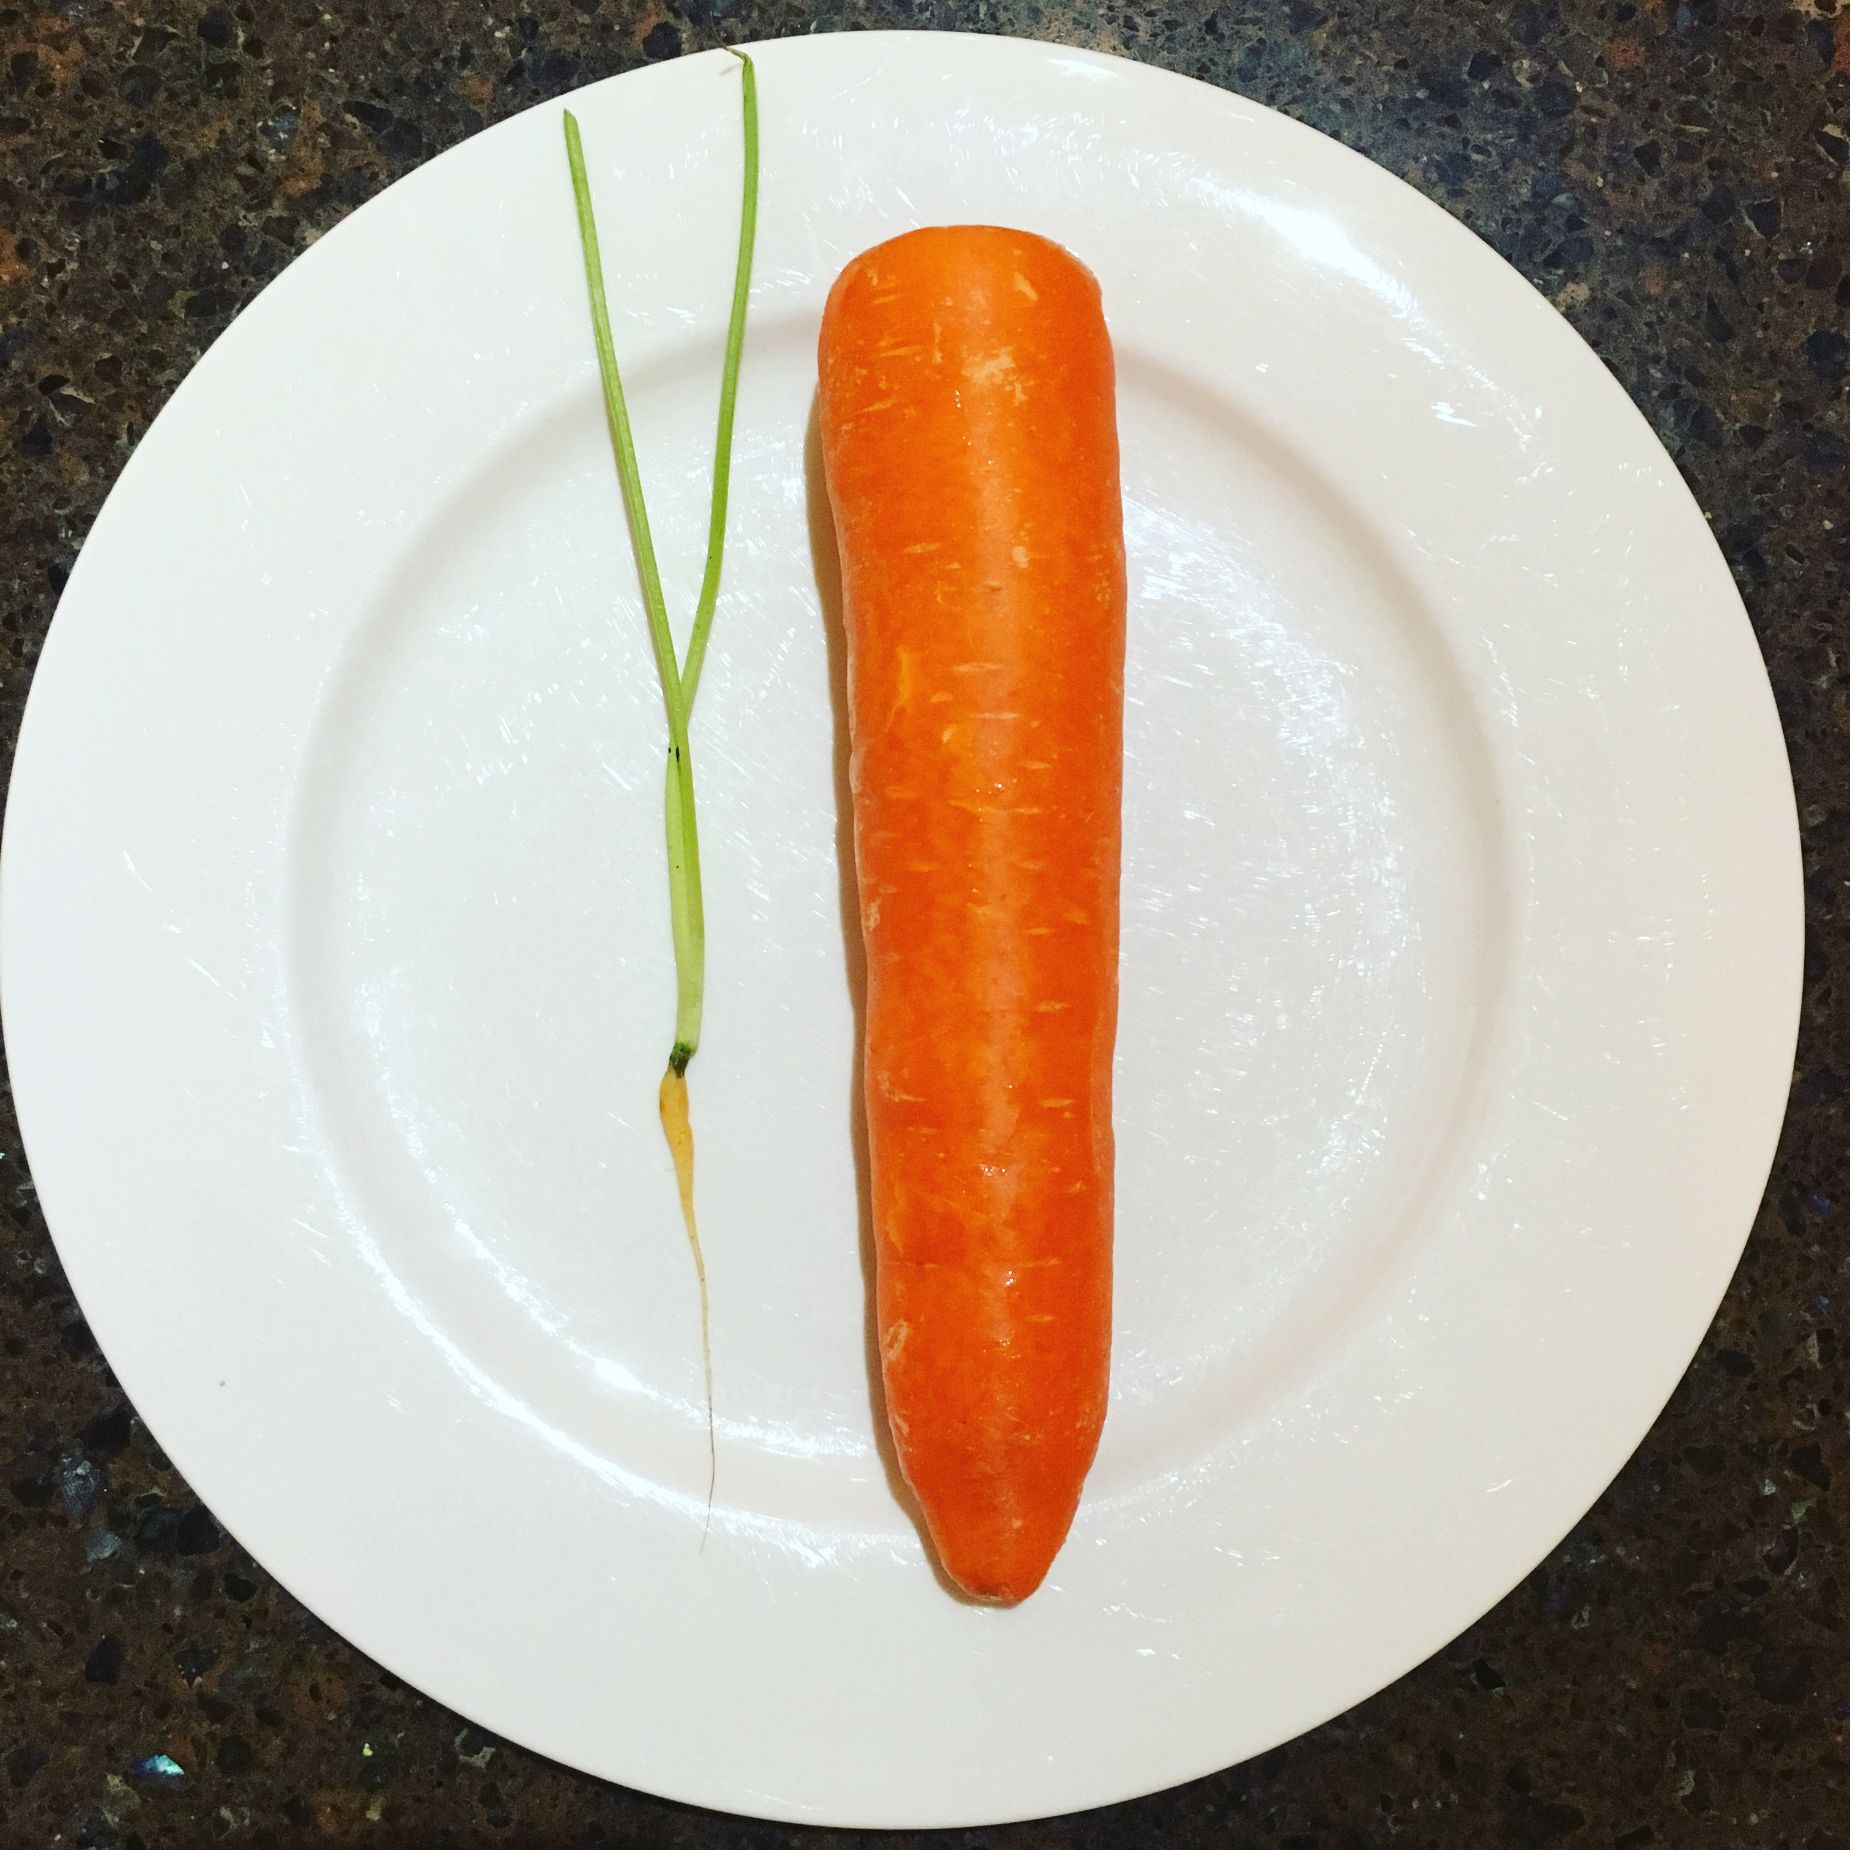

Slide 5
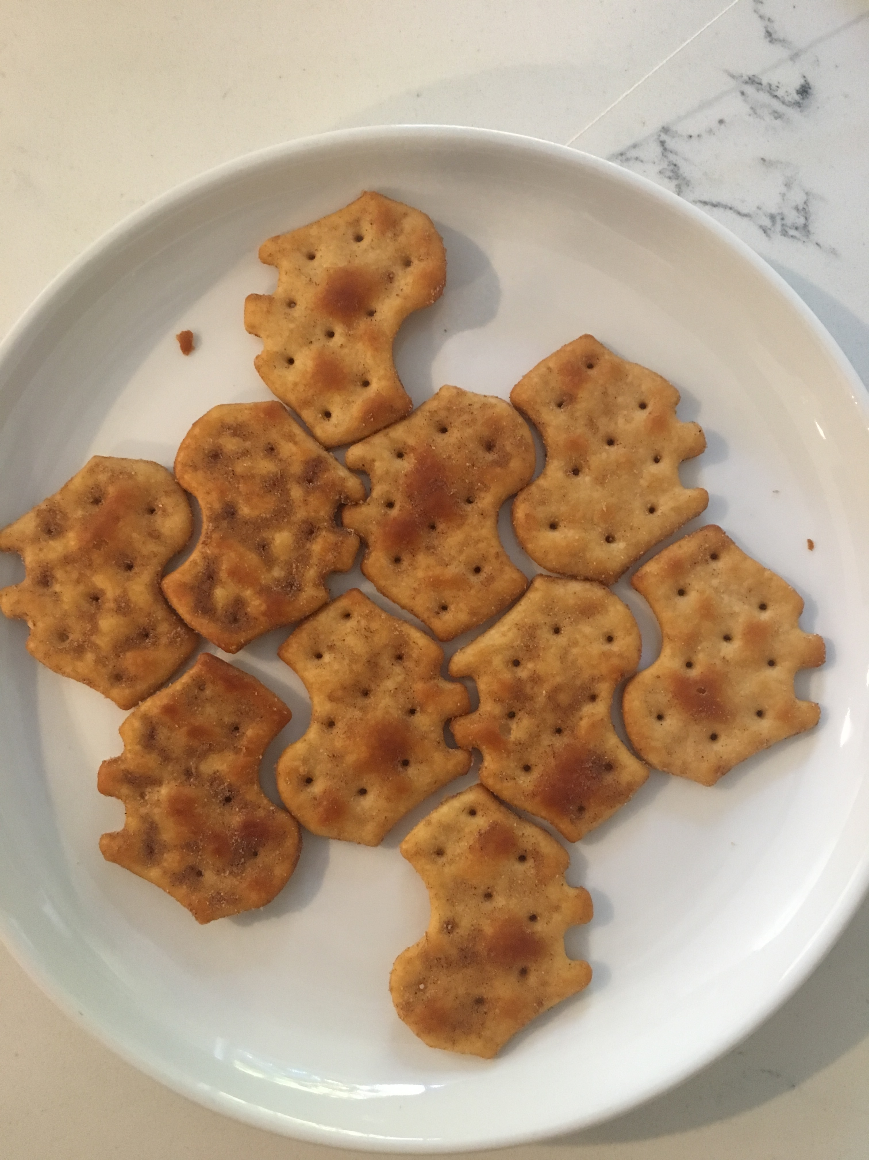

Slide 6
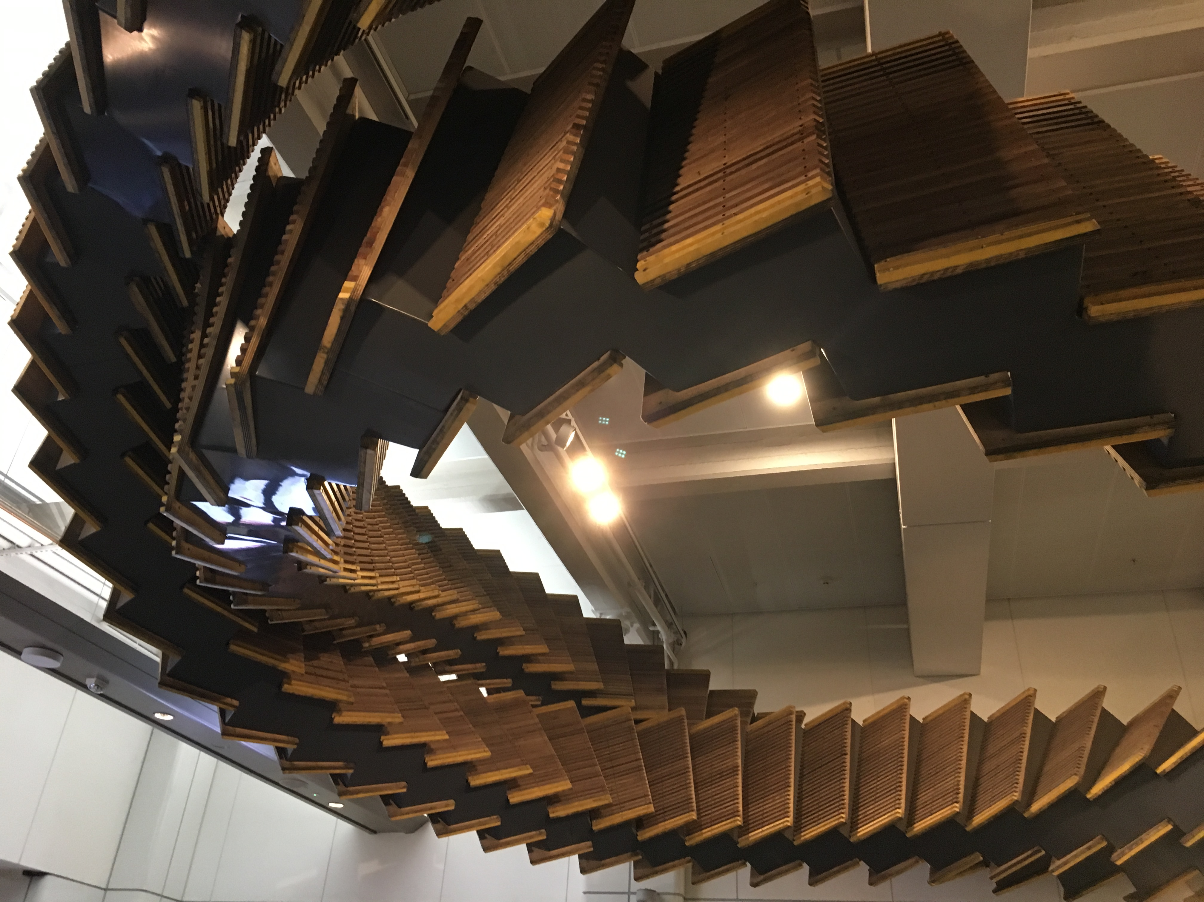

Slide 7
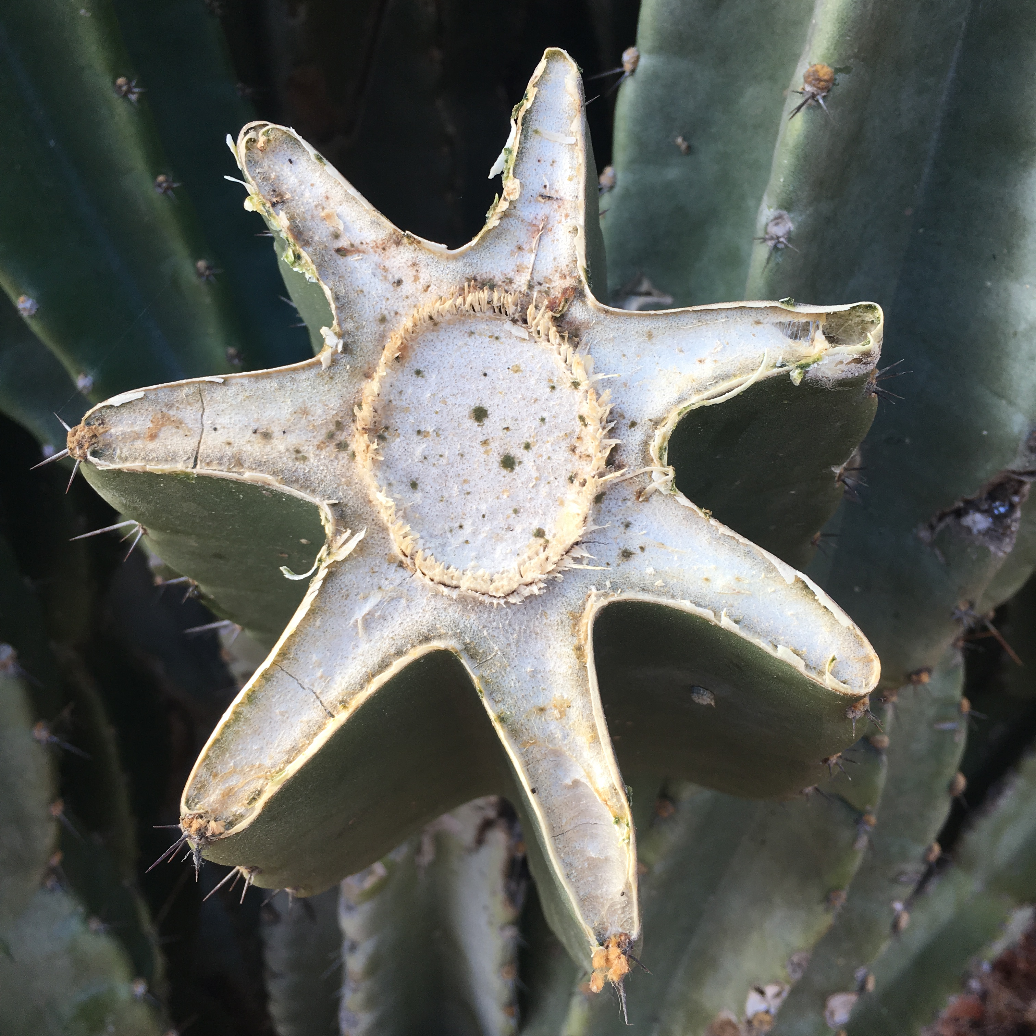

Slide 8
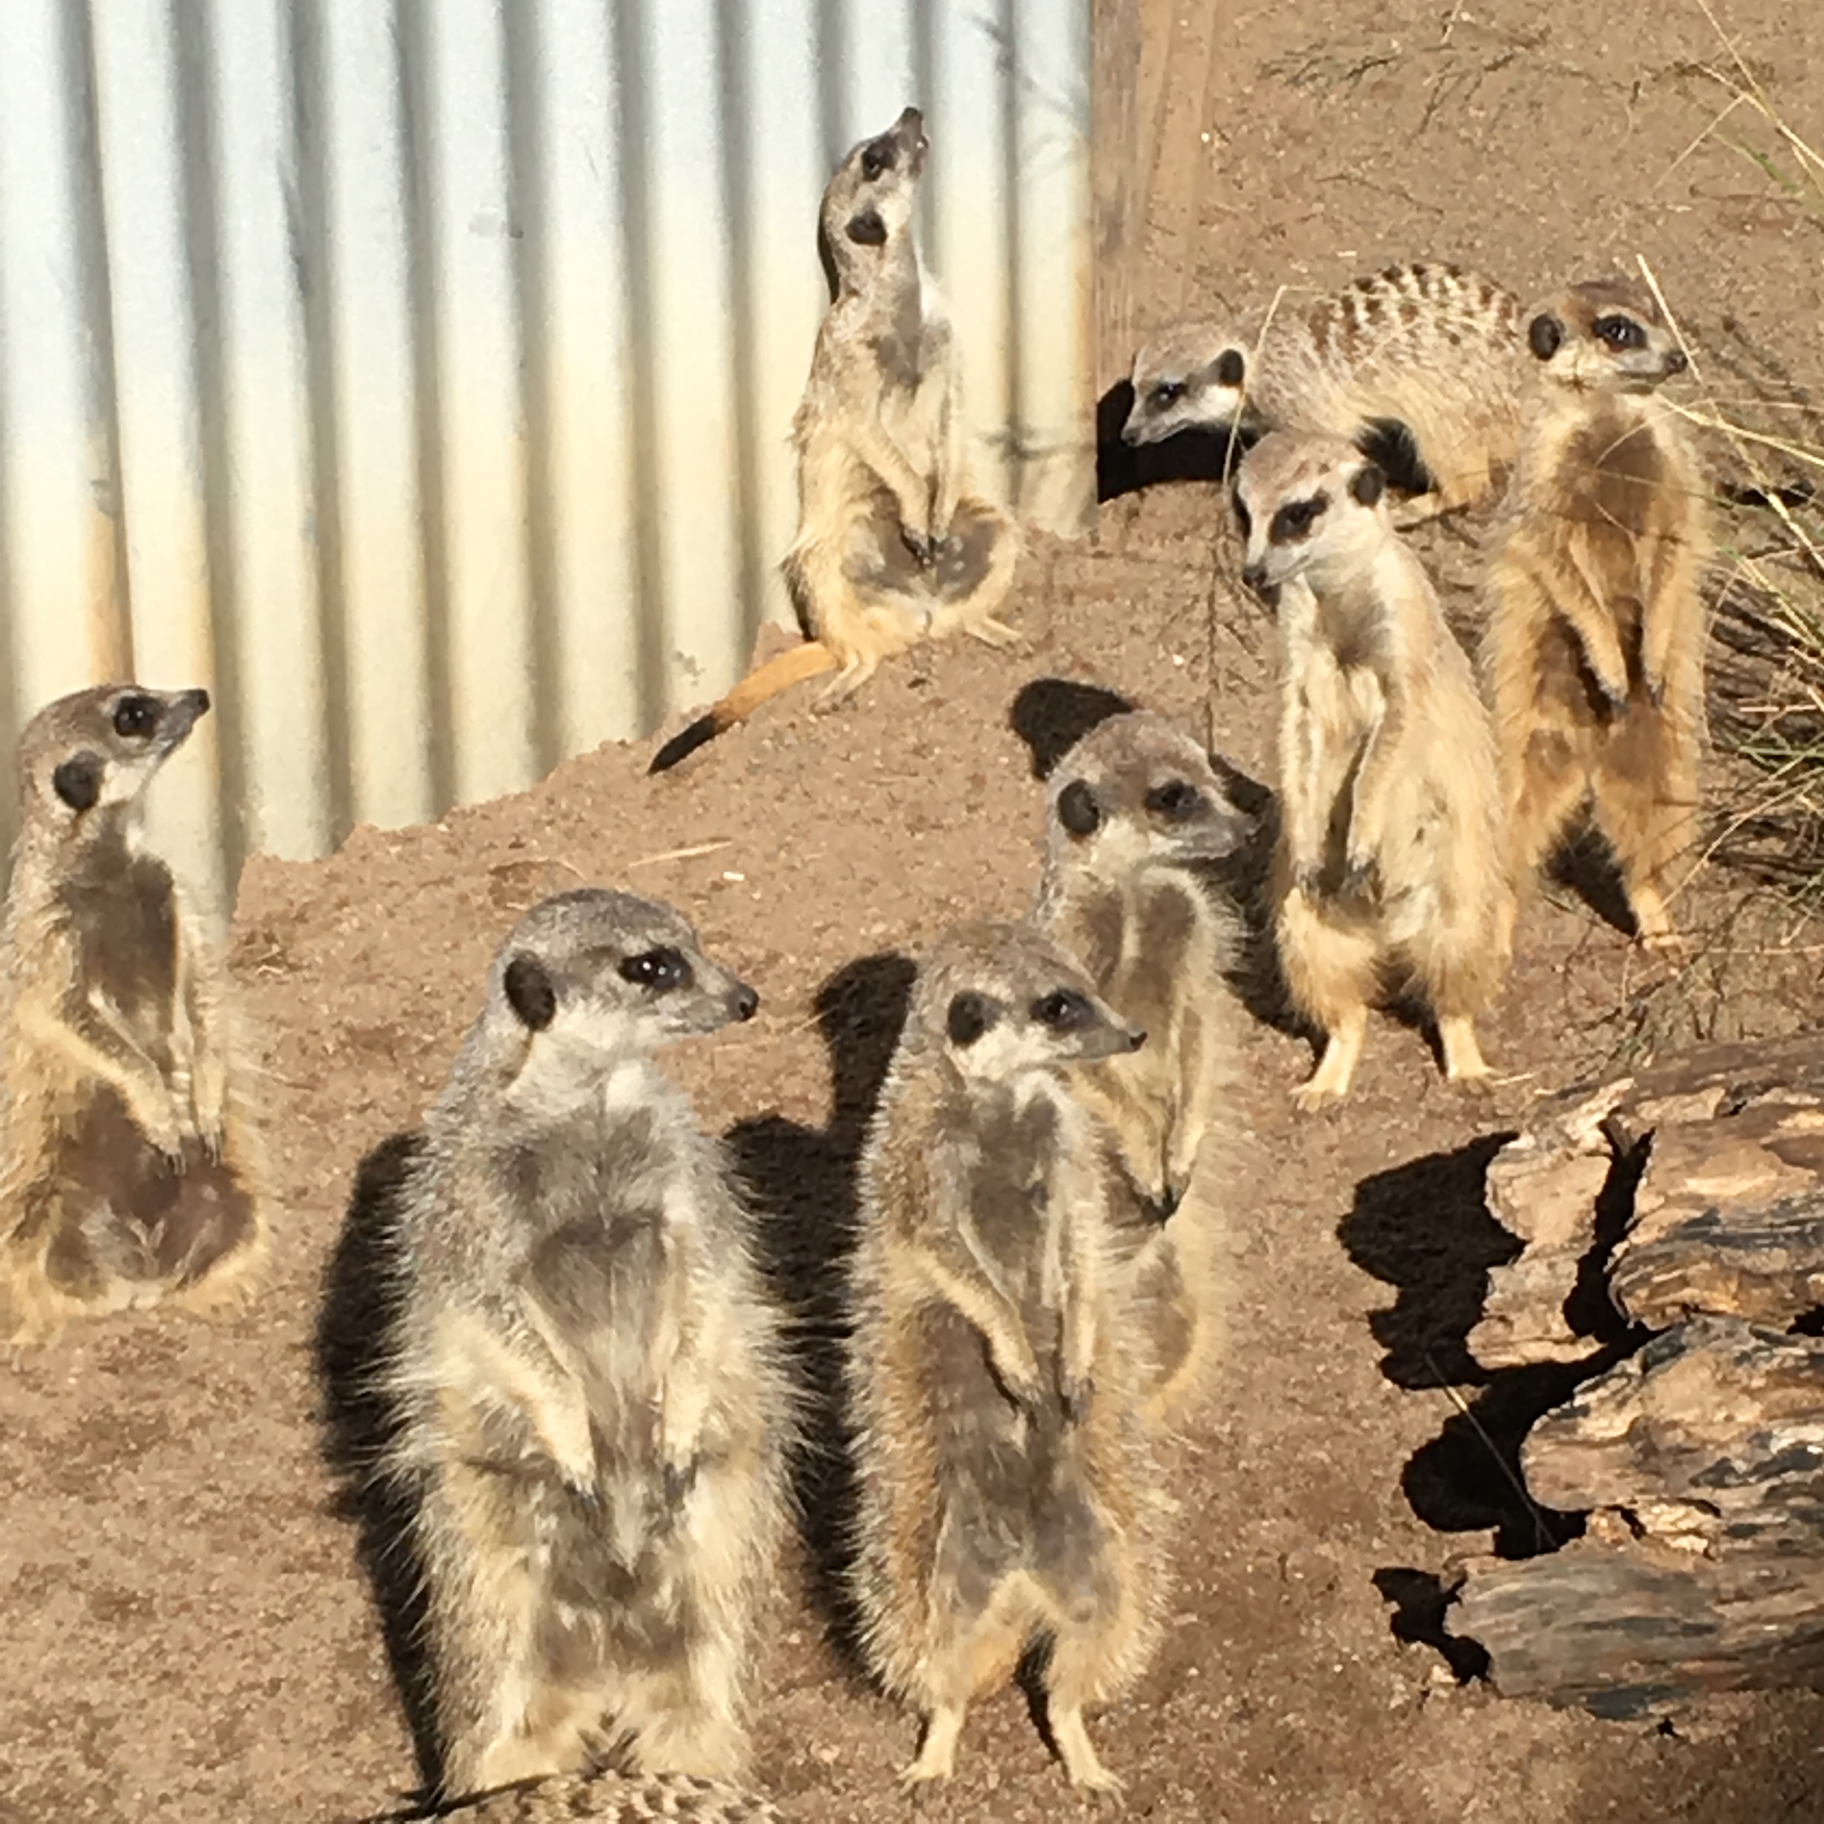

Slide 9
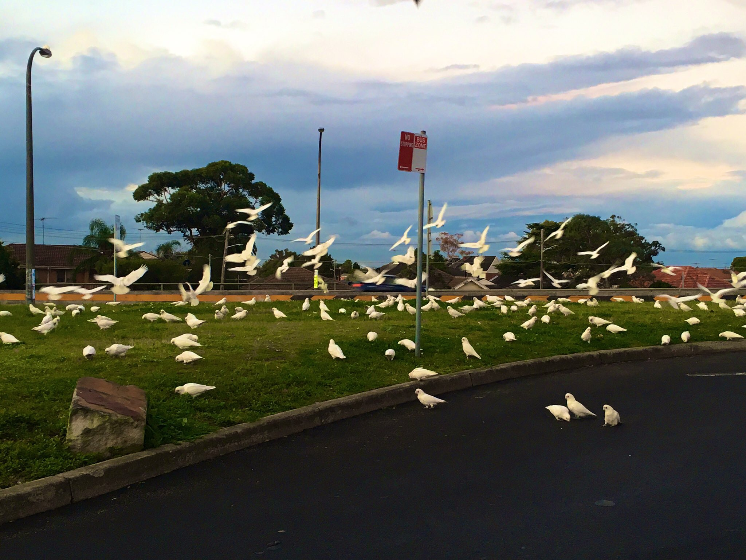

Slide 10
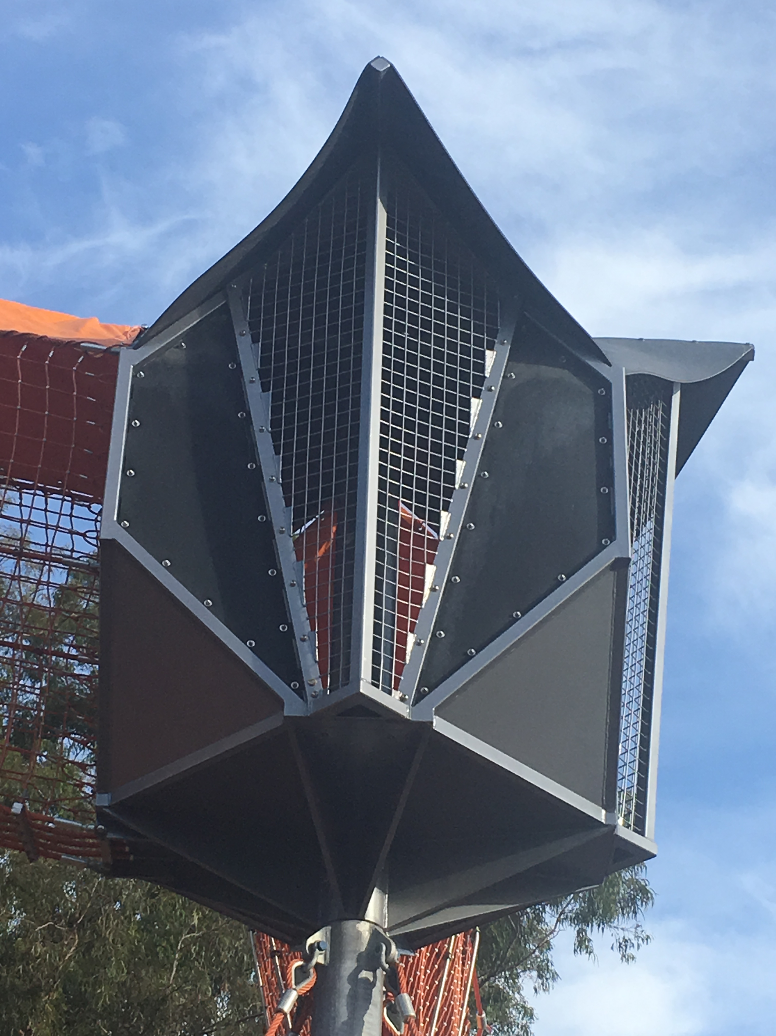

Slide 11
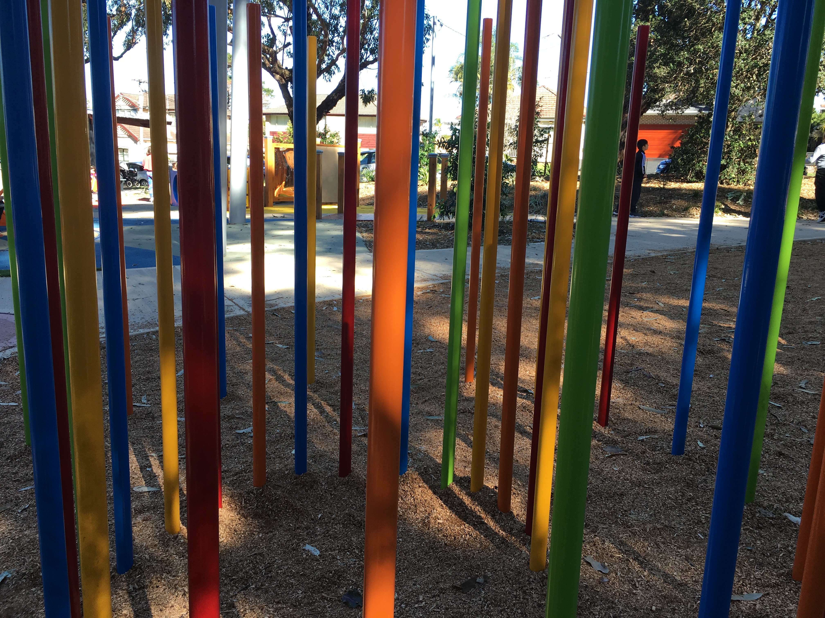

Slide 12
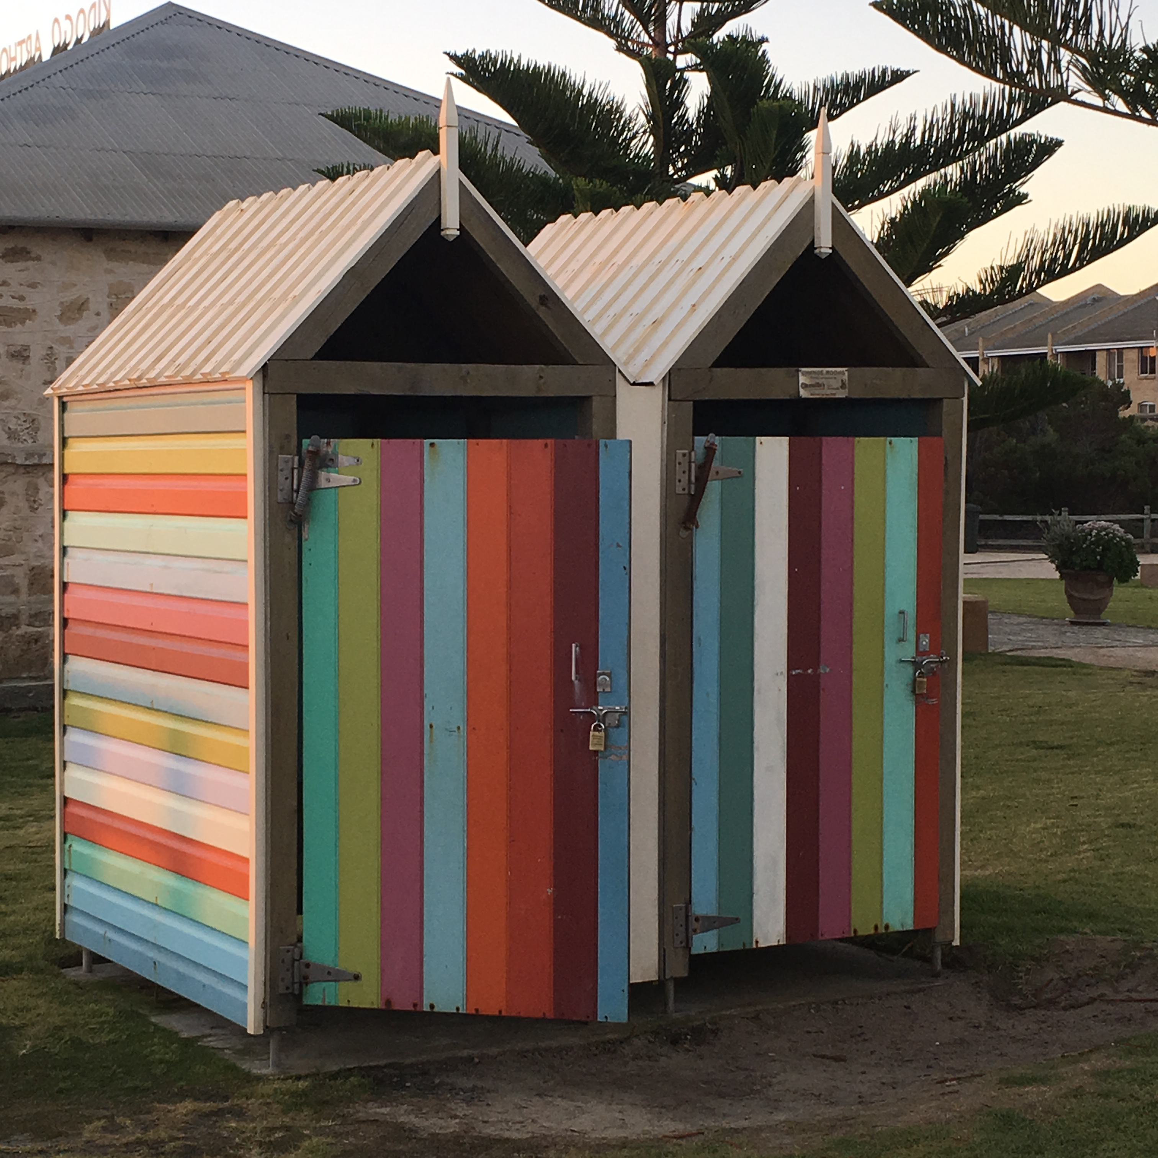

Slide 14
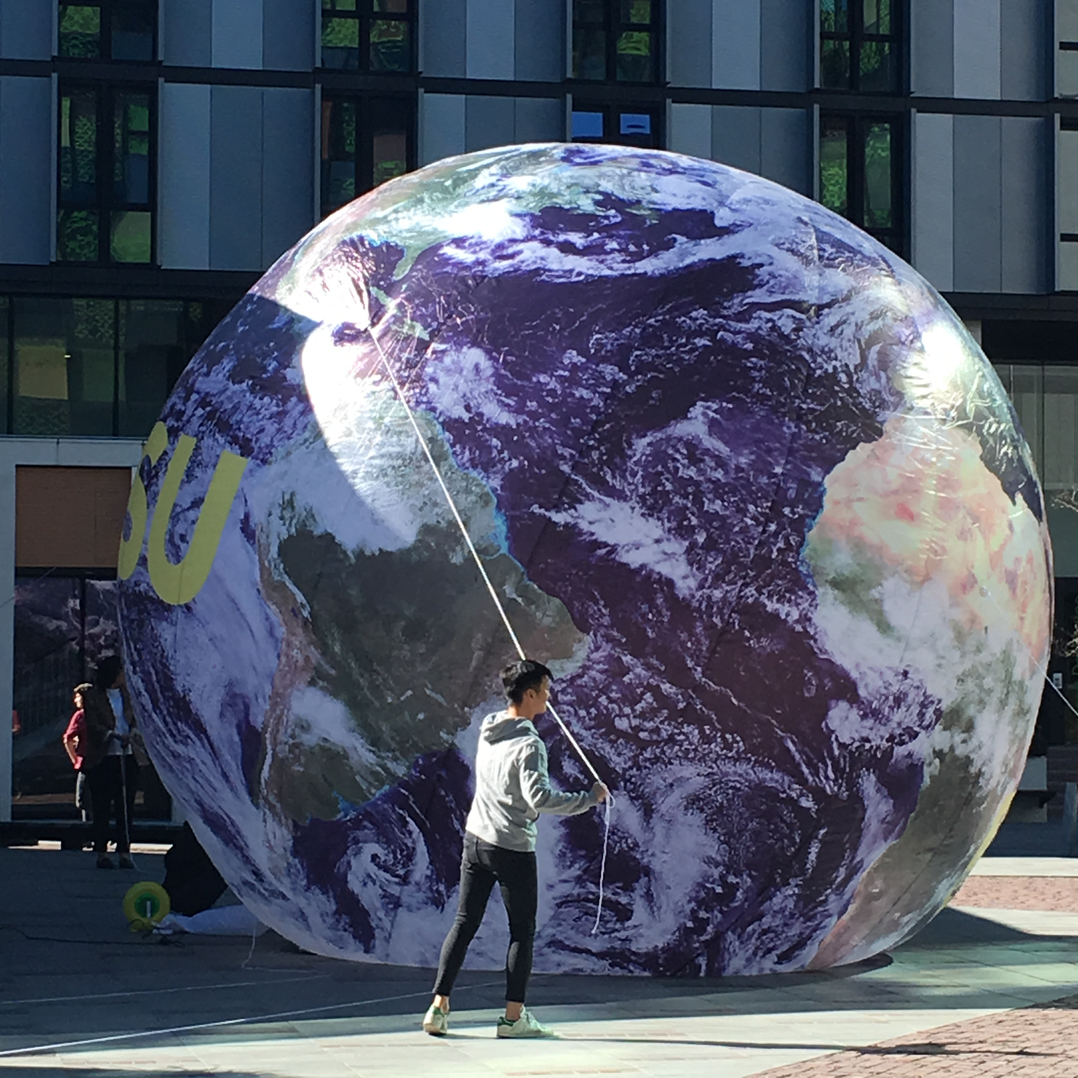

Slide 15
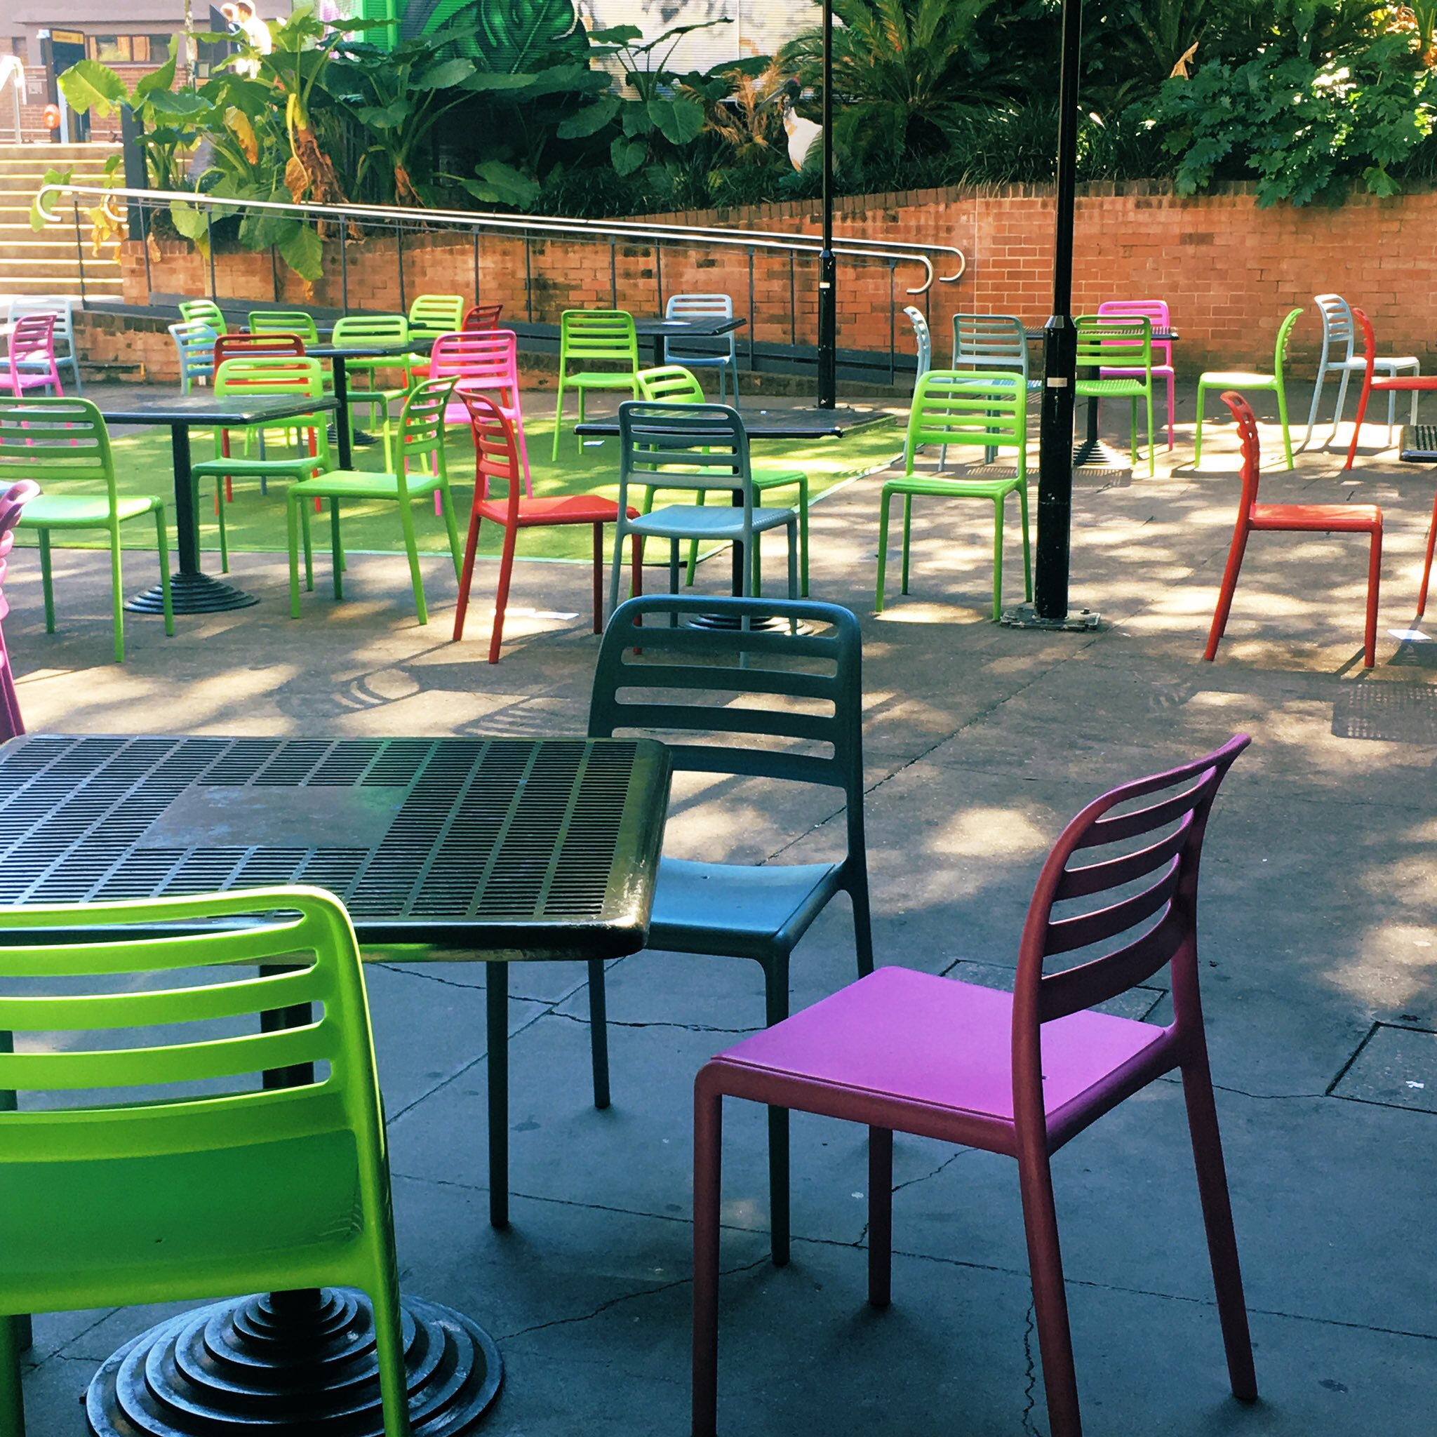

Slide 16
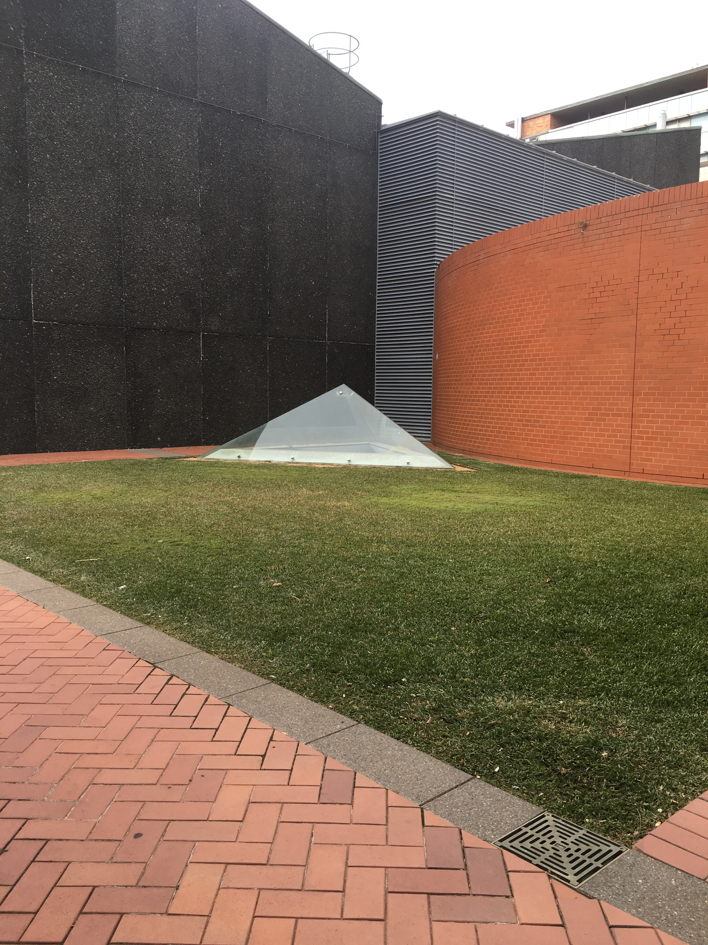

Slide 18
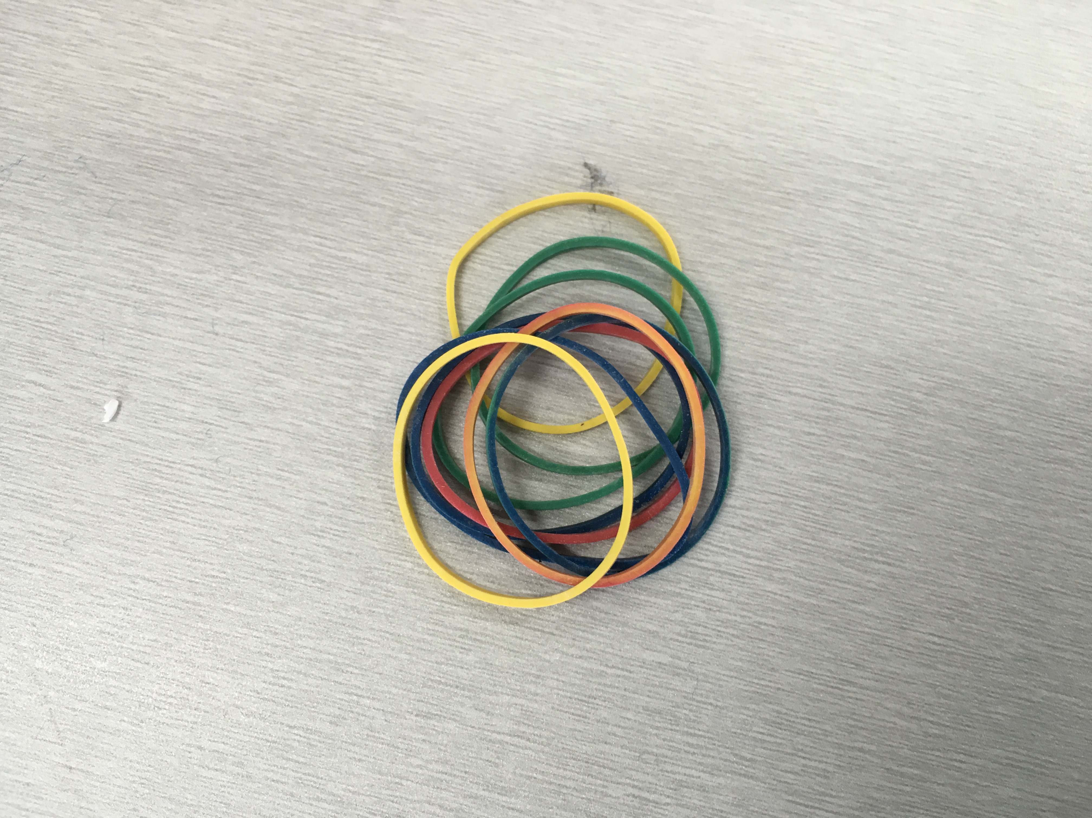

Slide 19
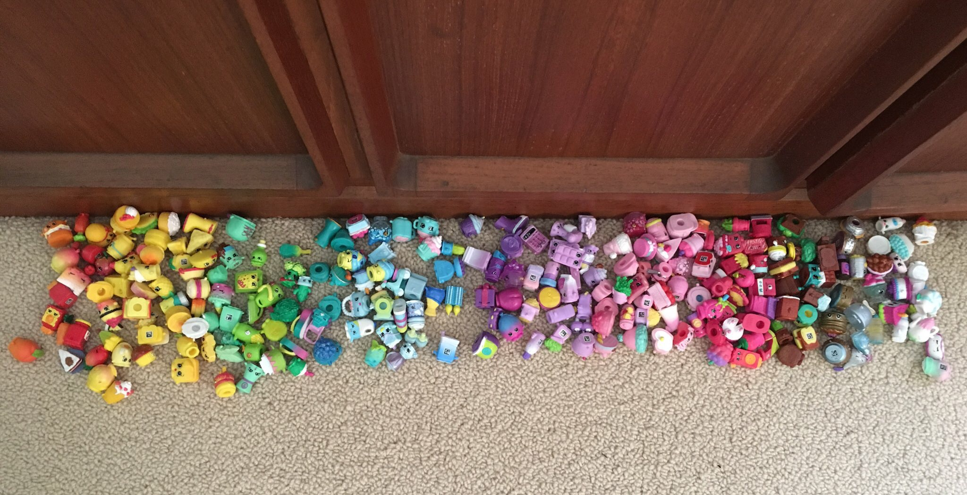

Slide 20
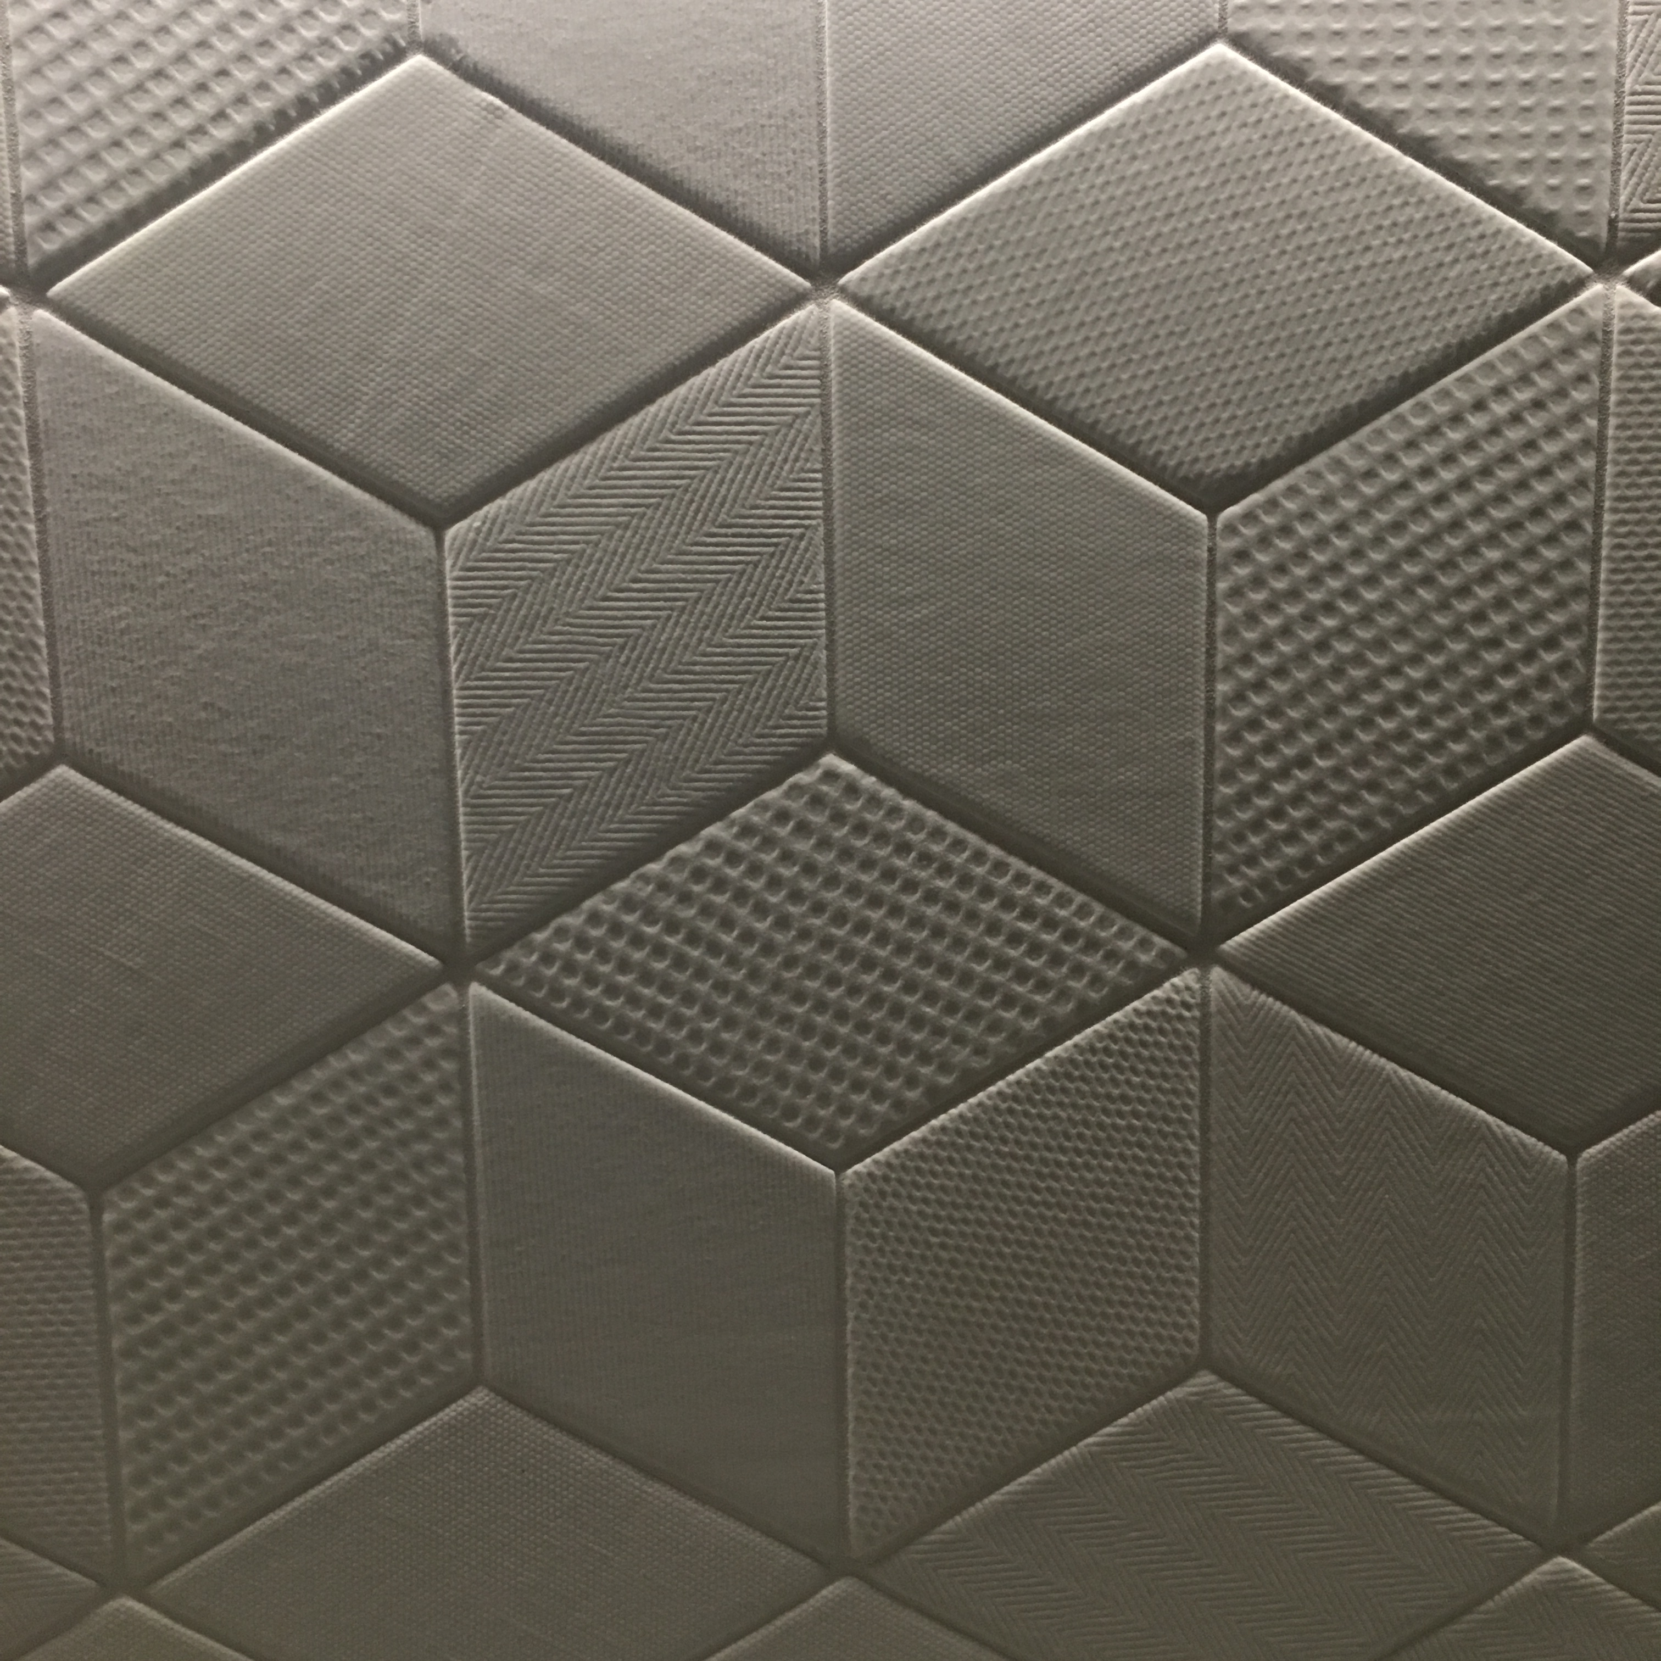

Slide 21
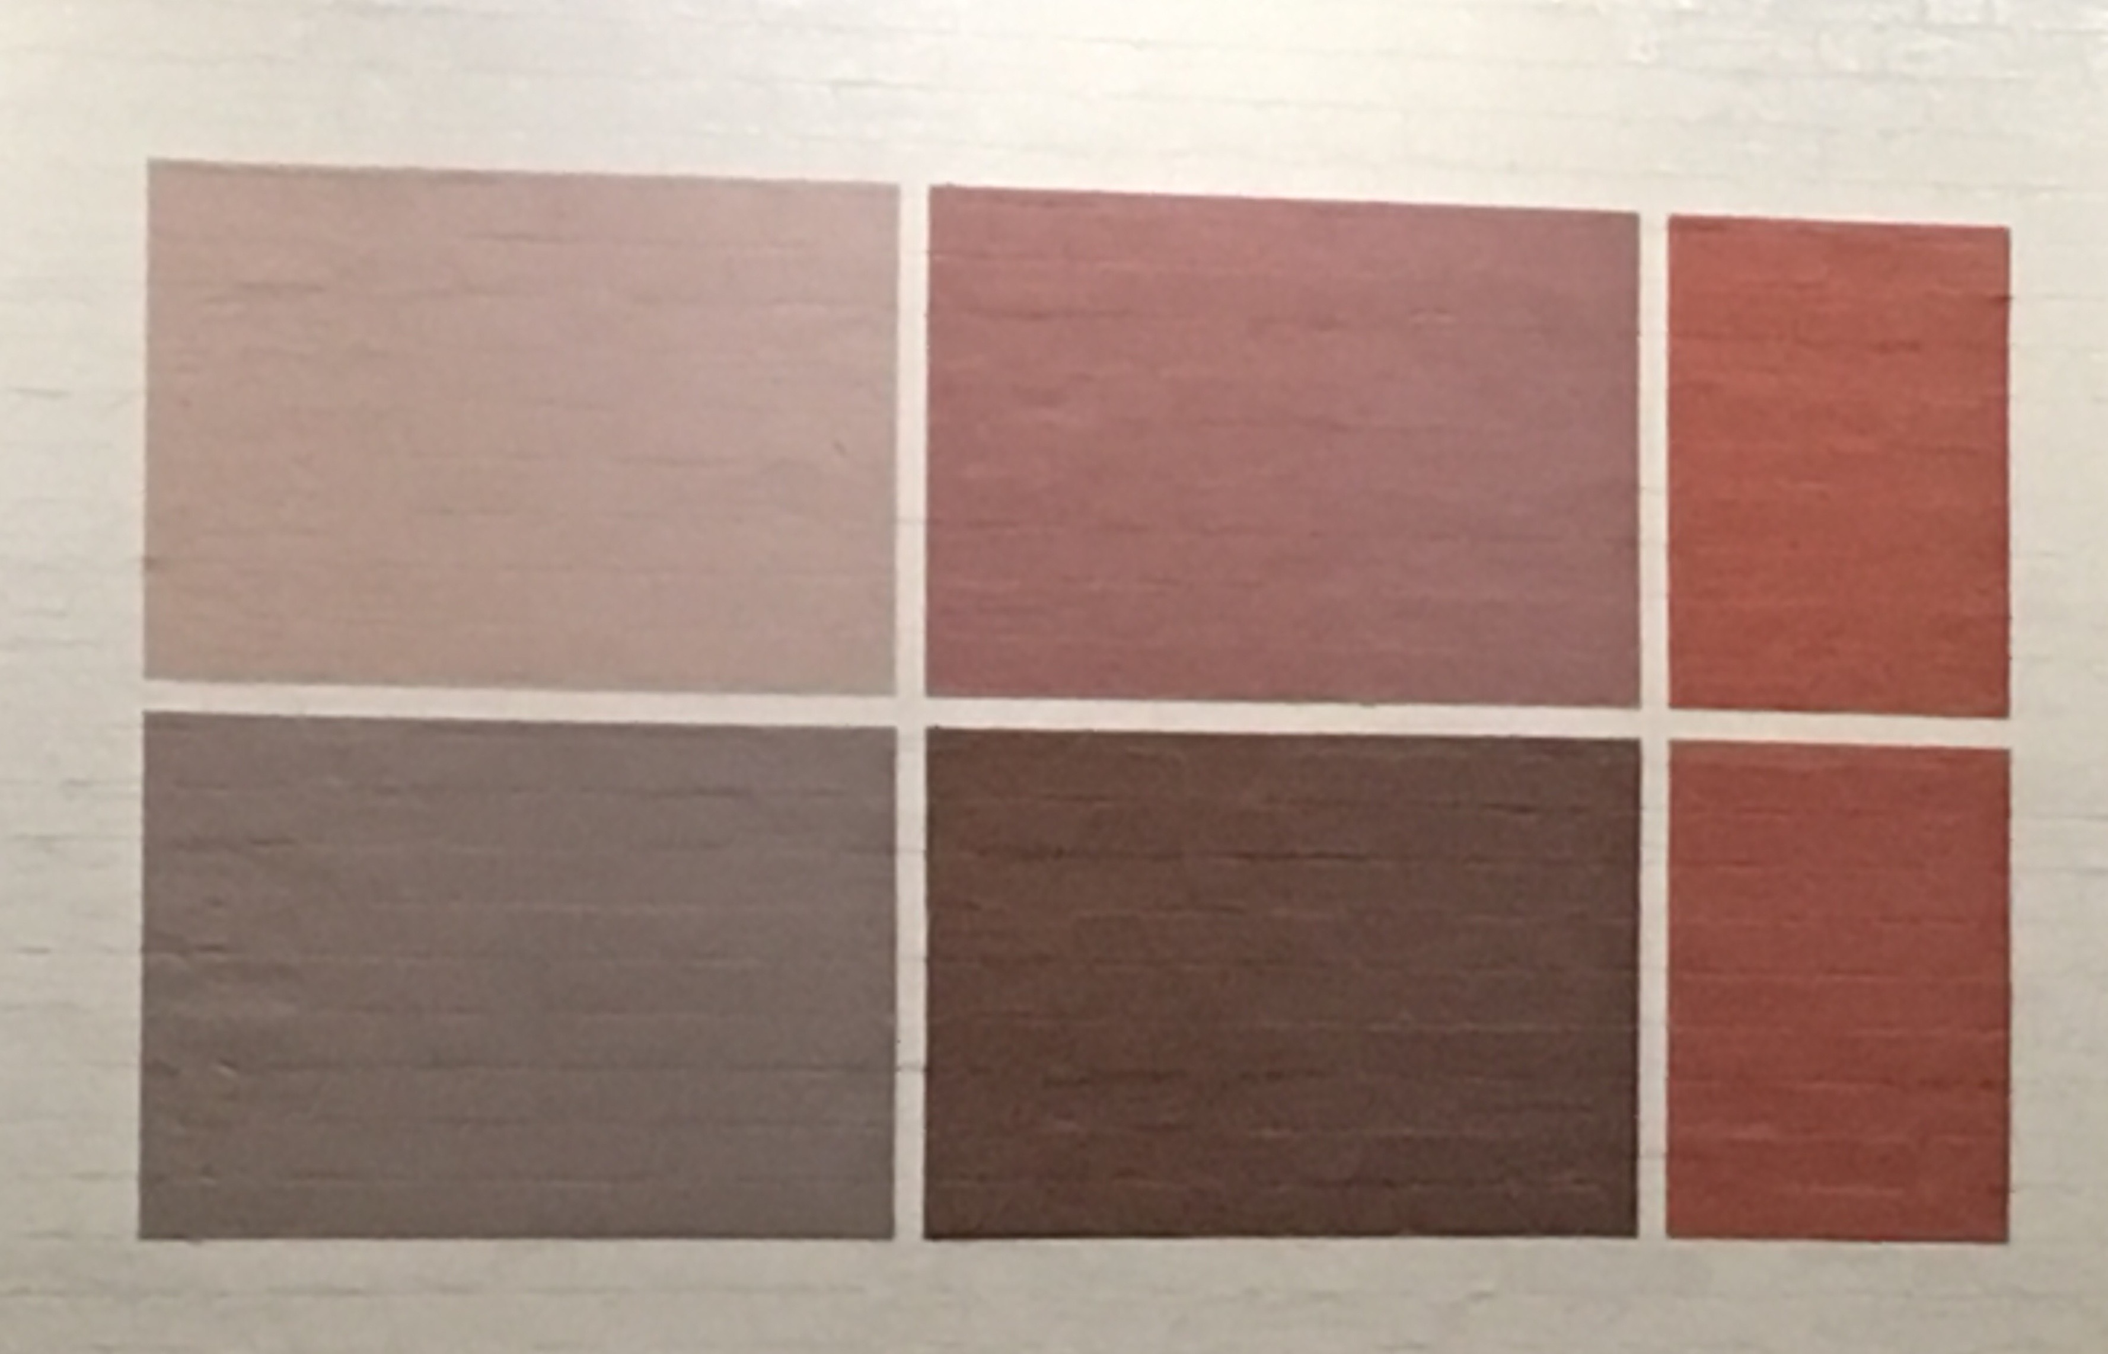

Slide 22
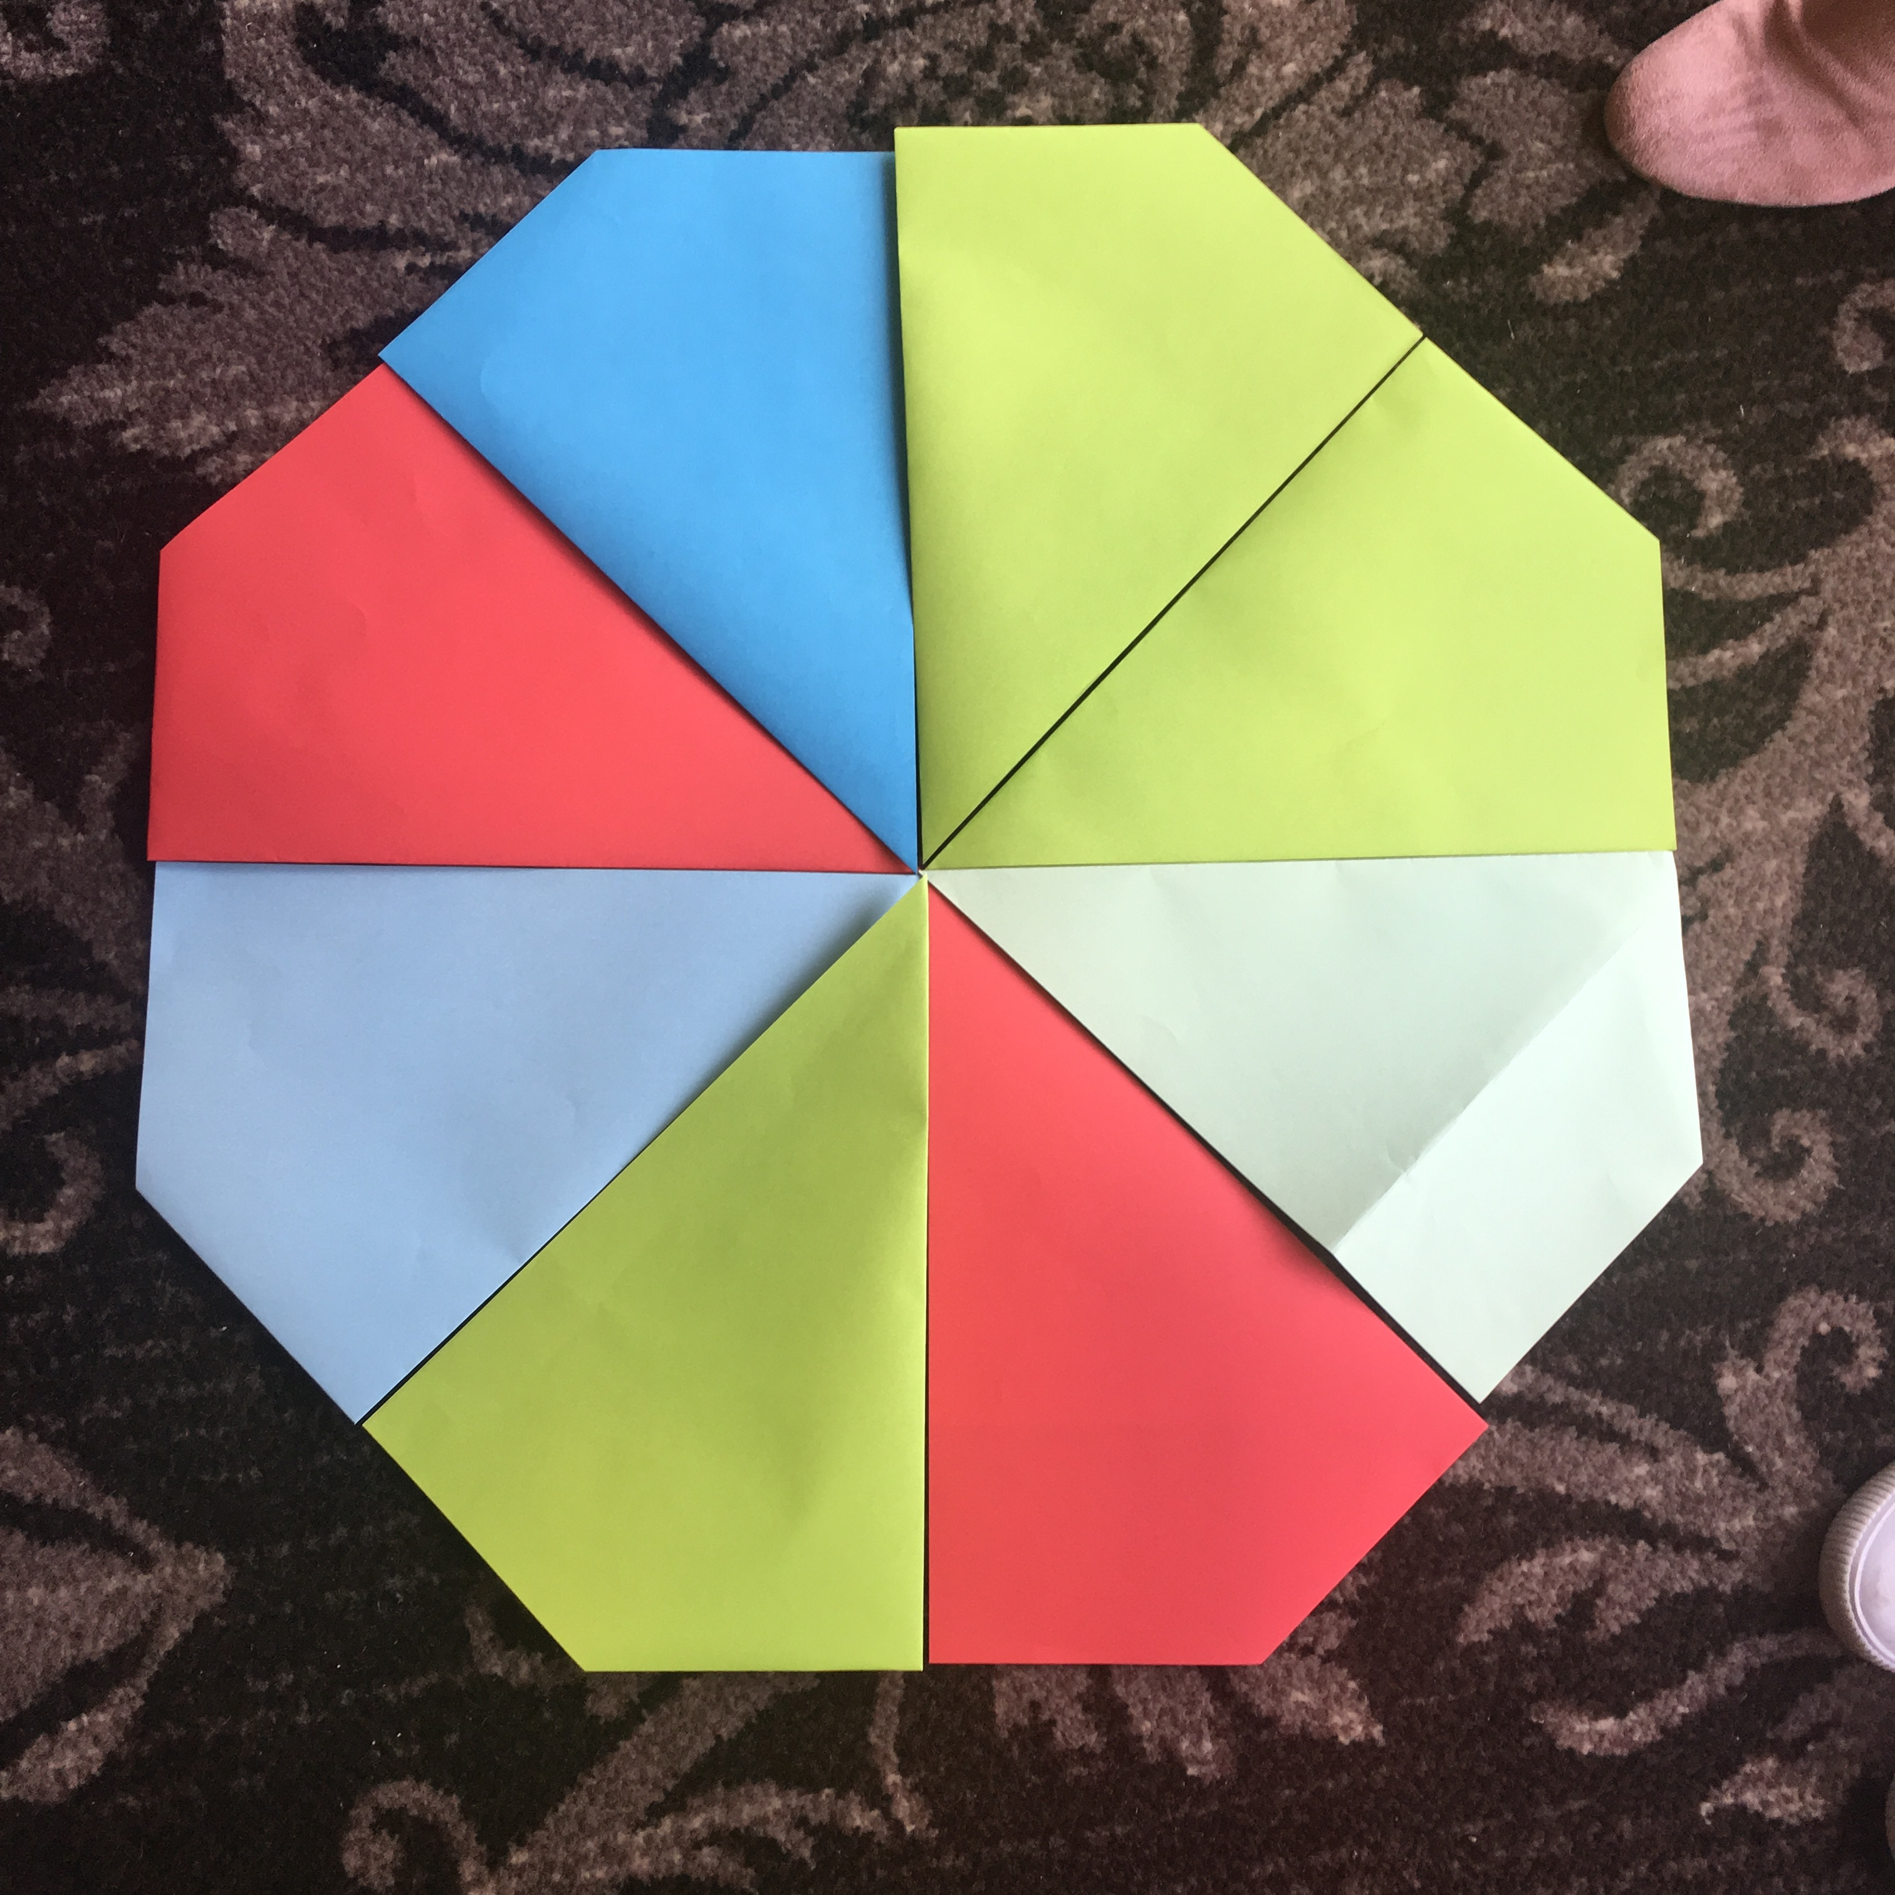

Slide 23
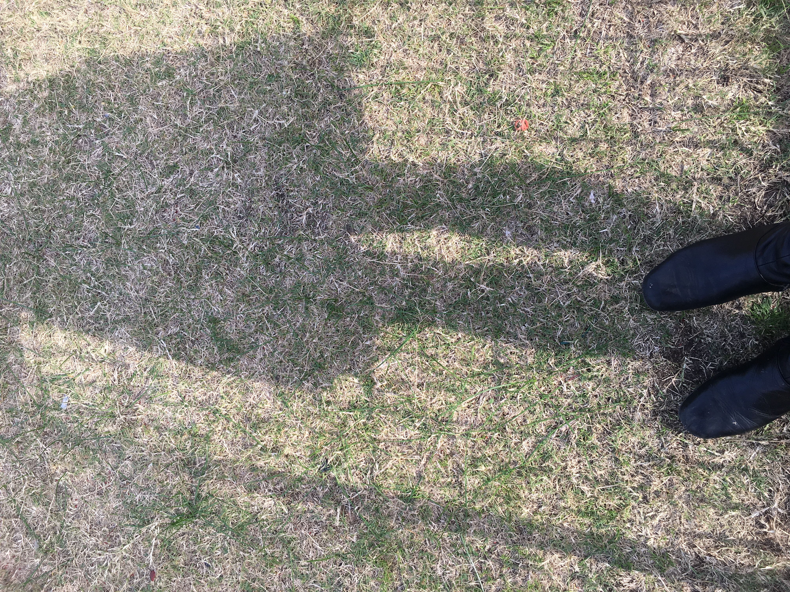

Slide 24
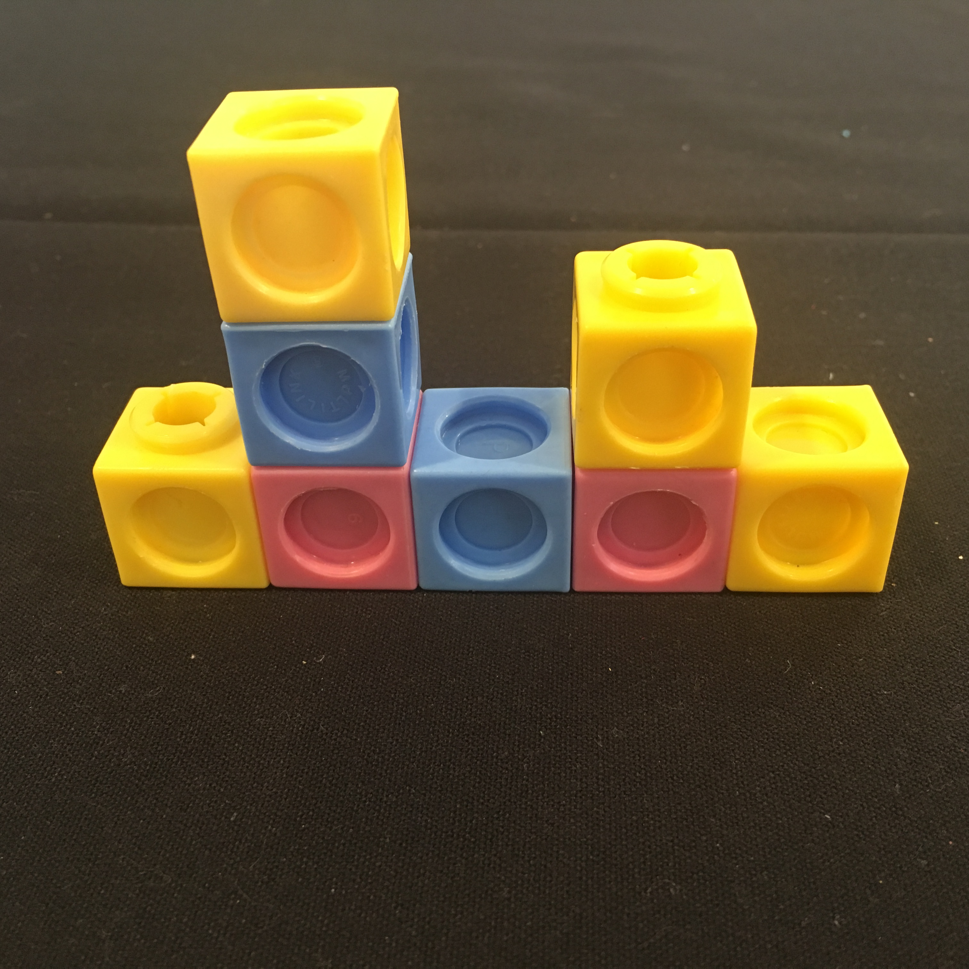

Slide 25
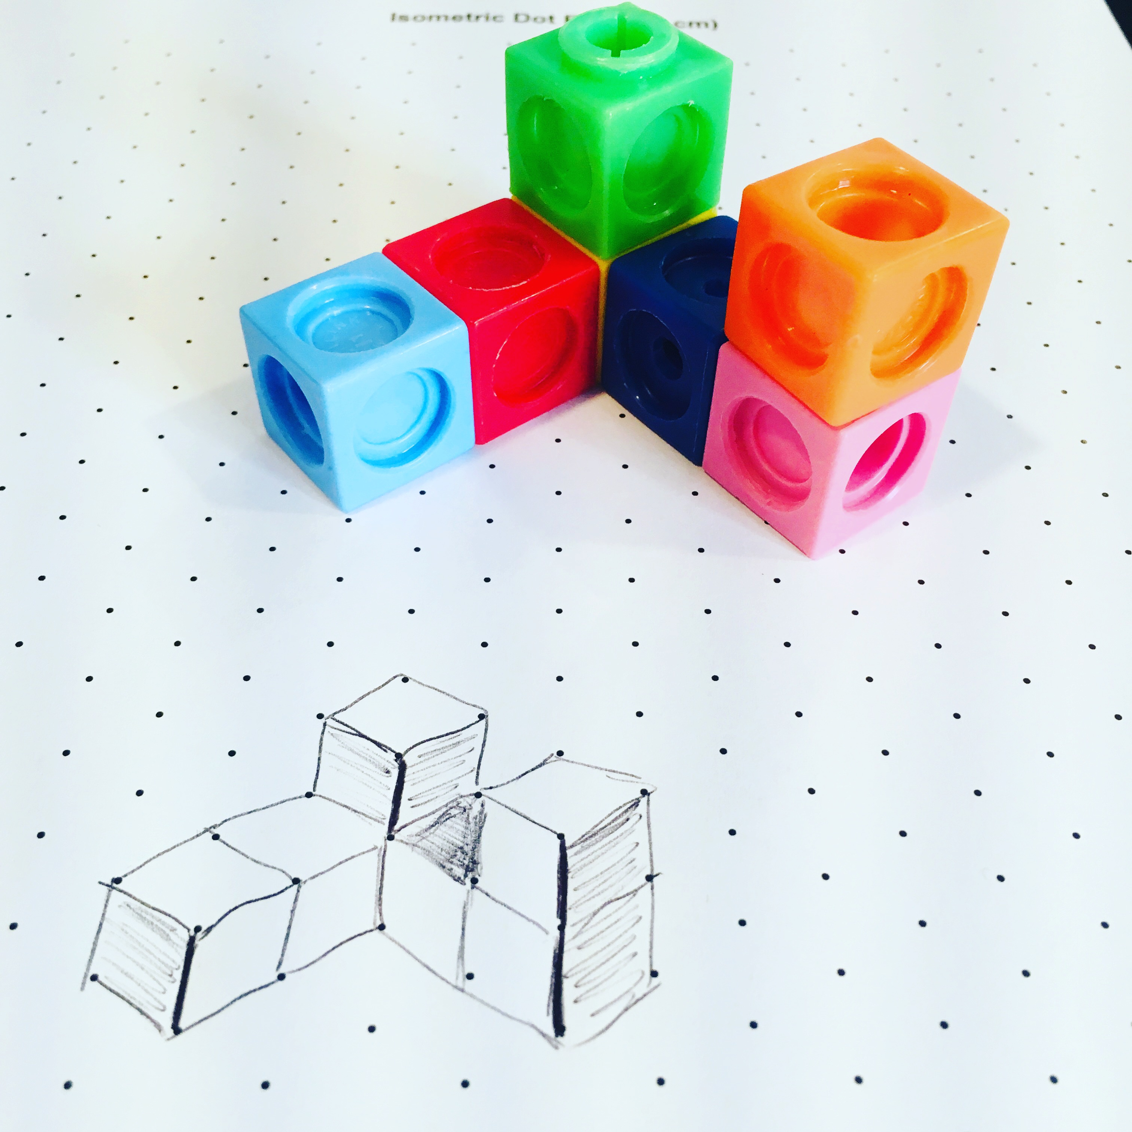

Slide 27
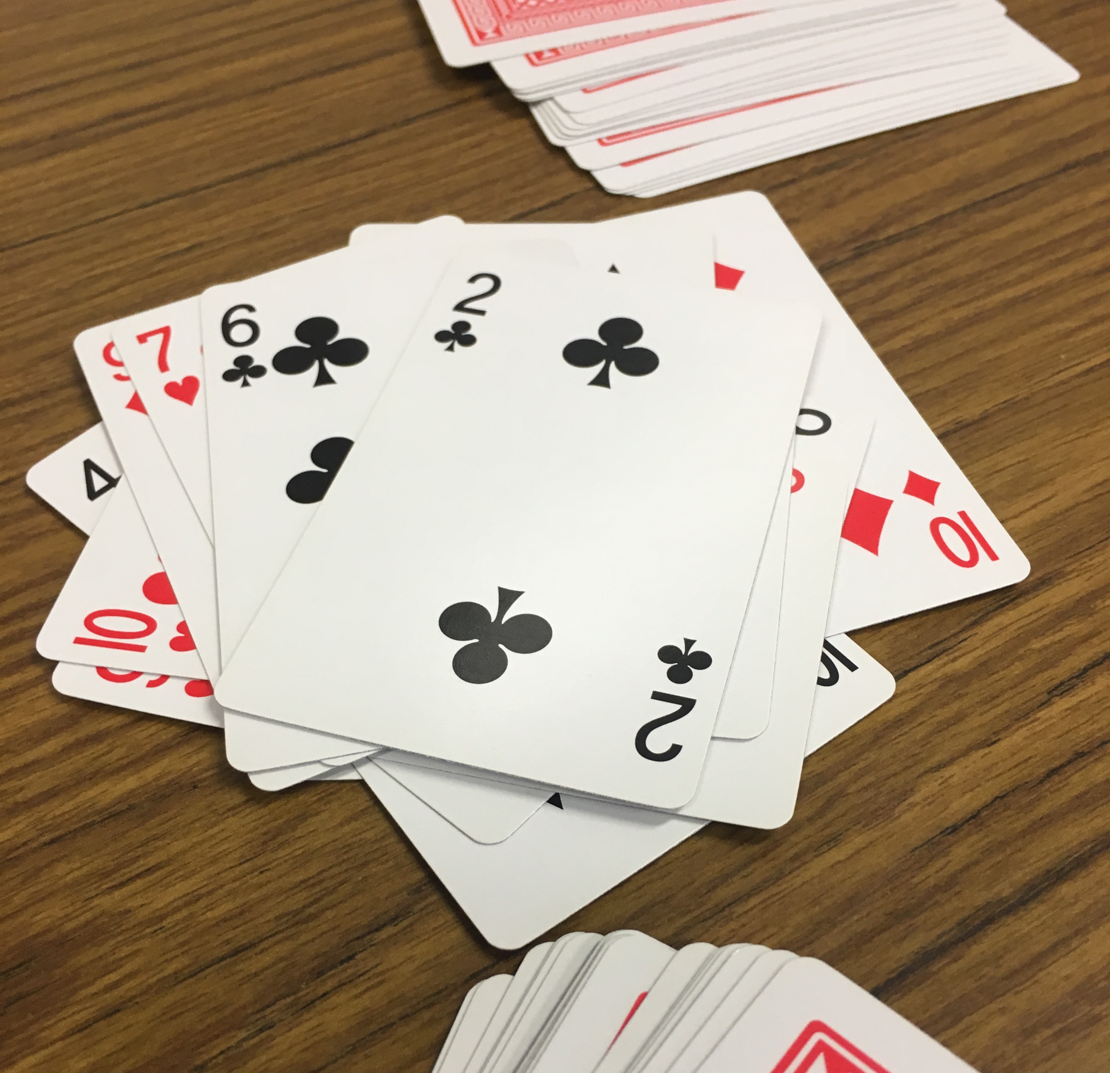

Slide 28
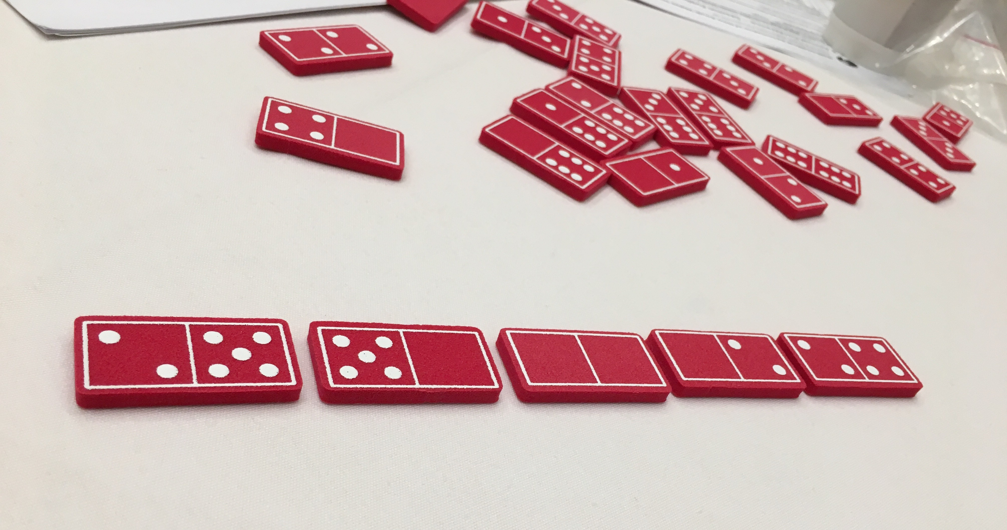

Slide 29
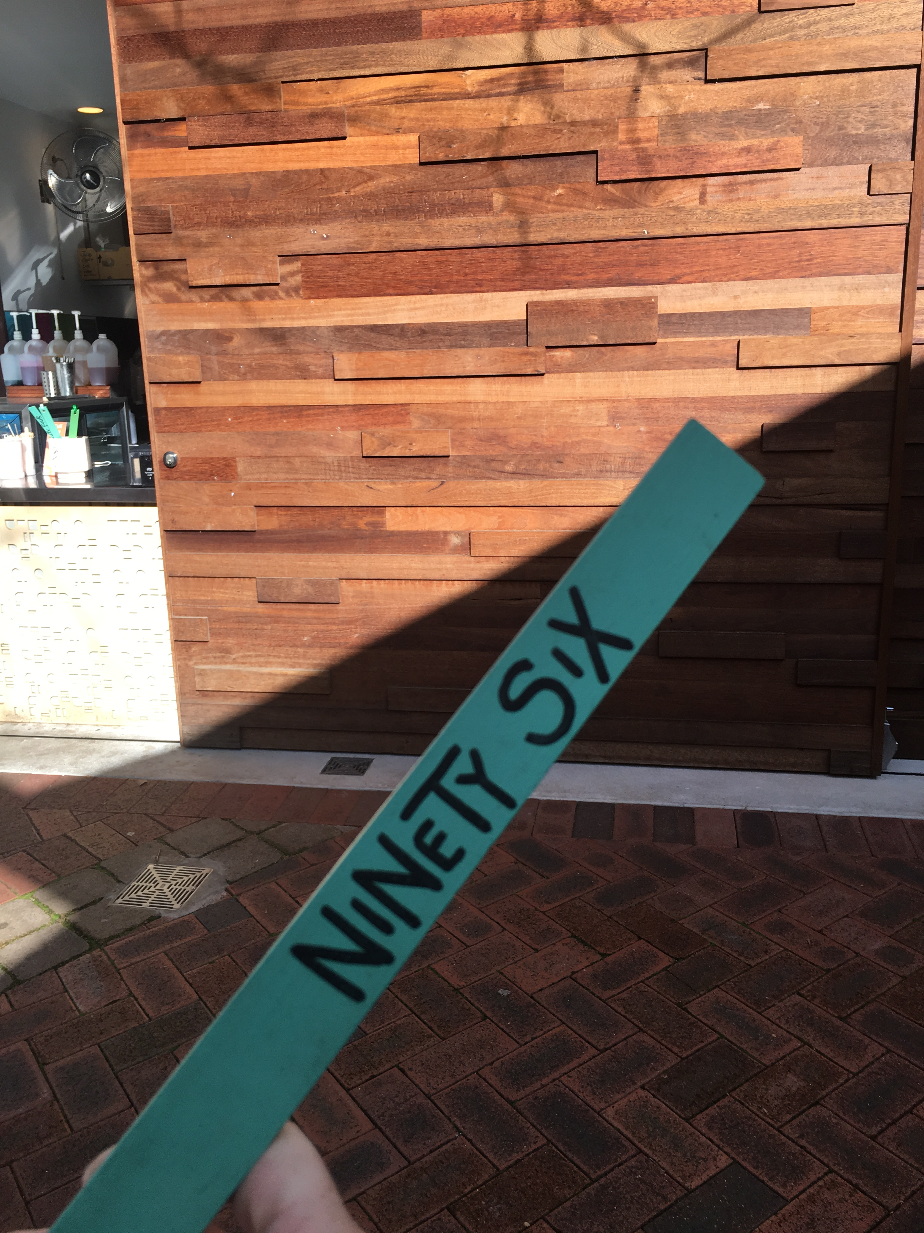

Slide 30
